Slide 1
Home work -1
Amit
Leibniz Universität Hannover

Slide 2
The motion of simple pendulum i.e. simple harmonic motion, can be represented with the following equation:
θʺ = - (g/l) × sin(θ)
where, g = acceleration due to gravity
l = length of the pendulum
θ = angle with the rest position
θʺ = double derivative of angle (angular acceleration)
Simulation starts with initial length (fixed), initial angle (which will be changing with time) and initial value of angular velocity (changes with time)
The language used for implementation is Python
To plot the output pyplot package is used from matplotlib library
Simple Pendulum / Circus Trapeze Simulation

Slide 3
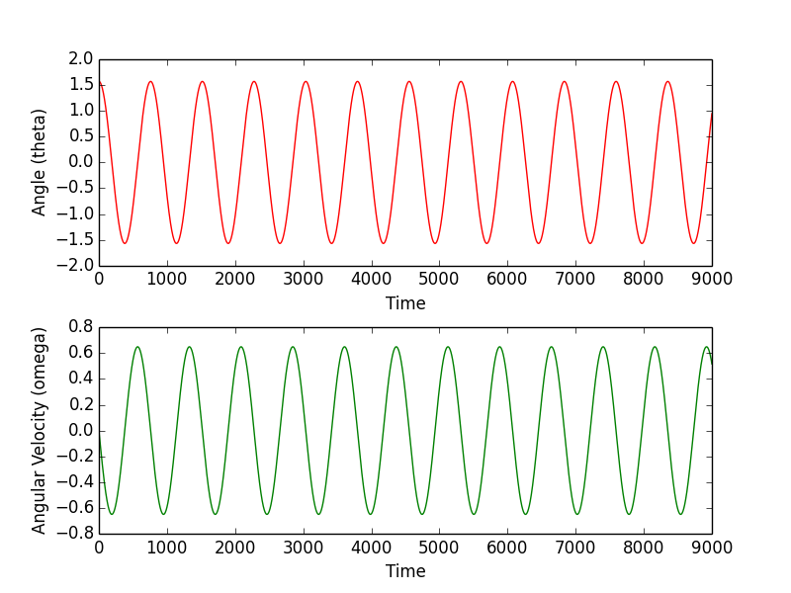
Results (Angle and Angular velocity)
Initial Values: length = 1.0, theta = pi/2, angular velocity = 0

